Slide 1

Watts Waters Technologies
PPAP Requirements

Slide 2
What’s PPAP?

Slide 3
What is PPAP ?
Production Part Approval Process
Standard used to formally reduce risks prior to product or service release, in a team oriented manner using well established tools and techniques.
Initially developed by AIAG (Auto Industry Action Group) in 1993 with input from the Big 3 - Ford, Chrysler, and GM.
AIAG’s 4th edition effective June 1, 2006 is the most recent version as of this print.
PPAP has now spread to many different industries beyond automotive, this is now becoming a standard in the Water industry.

Slide 4
Purpose of PPAP
Provide evidence that all customer engineering design record and specification requirements are properly understood by the organization.
To demonstrate that the manufacturing process has the potential to produce product that consistently meets ALL requirements during an actual production run at the quoted production rate.
PPAP manages change and ensures product conformance!

Slide 5
Watts Required Notification of Changes for PPAP Consideration:
Supplier notification to Watts is required for any planned changes to the design, process or site.
  Change of other construction or material than was previously approved.
  Production from new or modified tools , dies, molds, patterns, etc. including additional or replacement tooling. (except perishables).
  Change in part processing (upgrade or rearrangement of tooling).
  Production from tooling and equipment transferred to different plant site or from an additional plant location.
  Change of suppliers for parts, or material source changes or services.
  Tooling inactive greater than one year.
  Product & Process changes related to components of the production product manufactured internally or manufactured by suppliers. e.g. (form, fit, function, performance, durability).
  Changes in test/inspection methods – equivalent and (no affect on acceptance criteria).
  Bulk materials – new source of raw materials from new or existing supplier.
  Bulk materials - Change in product appearance attributes.
  New part or product, or color not previously supplied.
  Correction of discrepancy on previously submitted parts.
  Engineering change to design records specifications or materials for production product/part numbers.
  New process technology new to the organization not previously used for the product (bulk material).

Slide 6
Benefits of PPAP Submissions
Helps to maintain design integrity
Identifies issues early for resolution
Reduces warranty charges and prevents cost of poor quality
Assists with managing supplier changes
Prevents use of unapproved and nonconforming parts
Identifies suppliers that need more development
Improves the overall quality of the product & customer satisfaction

Slide 7
Production Run
PPAP data must be submitted from a production run using:
  Production equipment and tooling
  Production employees
  Production rate
  Production process
All data reflects the actual production process to be used at start-up!

Slide 8
Production Run Rate
The purpose of a Production Run Rate is to verify the supplier’s manufacturing process is capable of producing components that meet Watts quality requirements, at quoted tooling capacity, for a specified period of time.
Verification of the Run Rate will be at the Supplier Quality Engineer’s (SQE) discretion. The supplier will be notified of the need to perform a Run Rate as early in the process as possible.
The number of components to be produced during the Run Rate should be sufficient to demonstrate process capability and will be predetermined by the SQE and the supplier.
  Factors such as product complexity, shelf life, storage, cost and single shift vs. multiple shift operations will be taken into consideration.

Slide 9

Official PPAP Requirements
Design Records (Necessary part drawings, specification used to produce the product).
Authorized Engineering Change Documents
Customer Engineering Approval, (if required)
Design Failure Modes and Effects Analysis (DFMEA) applied in special situations
Process Flow Diagram
Process Failure Modes and Effects Analysis (PFMEA)
Control Plan
Measurement Systems Analysis (MSA) – [Gage R & R]
Dimensional Results
Records of Material / Performance Test Results
Initial Process Studies
Qualified Laboratory Documentation
Appearance Approval Report
Sample Production Parts
Master Sample (Master Part Retained on Site)
Checking Aids
Customer-Specific Requirements
Part Submission Warrant (PSW)

Slide 10
Watts PPAP Requirements
Design Records *
Authorized Engineering Change Documents
Team Feasibility Commitment (HQMS)
Customer Engineering Approval, (if required)
PPAP Report (Watts Requirements Checklist)
Design Failure Modes and Effects Analysis (DFMEA) applied in special situations*
Process Flow Diagram
Process Failure Modes and Effects Analysis (PFMEA)
Control Plan
Measurement Systems Analysis (MSA)
Dimensional Results (HQMS)
Records of Material / Performance Test Results (HQMS)
Initial Process Studies*
Qualified Laboratory Documentation
Appearance Approval Report (HQMS)
Sample Production Parts
Master Sample*
Checking aids (drawings)*
Watts -Specific Requirements*
Part Submission Warrant (PSW) – “Production Warrant
Packaging Requirements
Supplier shall retain these *6 items at appropriate locations, and make readily available upon request.

Slide 11
PPAP Submission Levels
Level 1 Production Warrant and Appearance Approval Report
(if applicable) submitted to Watts.
Level 2 Production Warrant, product samples and dimensional results submitted to Watts.
Level 3 Production Warrant, product samples and complete supporting data submitted to Watts.
Level 4 Production Warrant, and other requirements as defined by Watts.
Level 5 Production Warrant, product samples and complete supporting data (review will be at the organizations location).

Slide 12
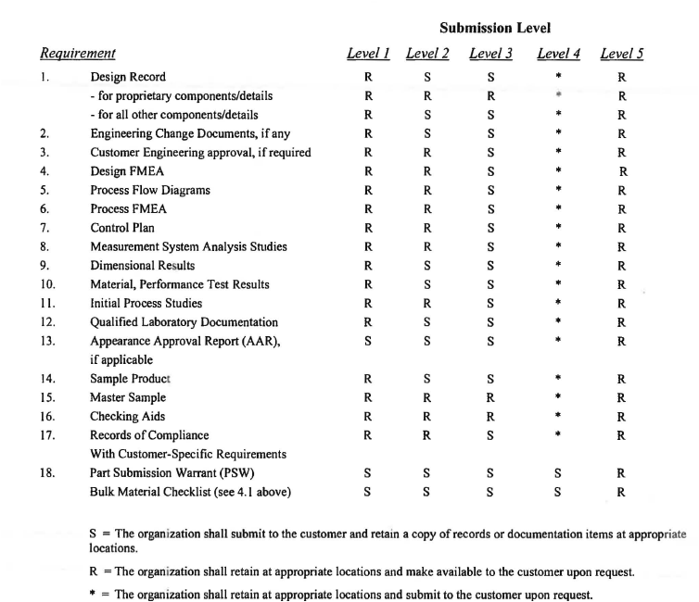
PPAP Submission Level Table
* = Supplier shall retain at appropriate locations, and submit to Watts upon request. Watts will identify what is needed for submission.
R = Supplier shall retain at appropriate locations and make readily available to Watts upon request.

Slide 13
Definitions of Risk
High Risk
  Parts associated with multiple critical features, complex design, or high end technology that is not yet established in the general manufacturing environment.
  Supplier’s quality system and/or quality performance is not to Watt’s satisfaction.
Medium Risk
  Parts that have at least one critical feature.
Low Risk
  Parts that have no critical features and can be manufactured by any manufacturer in the commodity category.
  Supplier’s quality system and quality performance are acceptable.

Slide 14
Submission Level Requirements
New Parts
  Level 3 is required for all New Part Numbers.
Part Changes
  Level 3 is required for Parts produced at a new or additional locations and is the default level for Watts products.
  Review PPAP 4th edition requirements for further defined details for notification of changes and PPAP requirements.
Watts reserves the right to redefine the submission level required.

Slide 15

PPAP Status
  Approved
  The part meets all Watts requirements.
  Supplier is authorized to ship production quantities of the part.
  Deviation
  Permits shipment of part on a limited time or piece quantity basis under deviation.
  Rejected
  The part does not meet Watts requirements, based on the production lot from which it was taken and/or accompanying documentation.
Production quantities may not be
shipped before Watts Approval

Slide 16
Electronic Submission Requirements
Watts requests that all PPAPs be submitted electronically via Watts HQMS. (Harrington Quality Management System).
Use of paper submission must have prior approval by the Watts.
Submission must be received on or prior to the PPAP due date.
Review and Approval Process:
  Watts will review and provide feedback within 10 business days.

Slide 17
Watt’s PPAP Documents
  What are Watt’s PPAP Documents?
  An Excel spreadsheet containing labels & templates of the documents suppliers are required to submit to Watts. These PPAP documents can be found on our supplier website: www.wattswater.com/Suppliers
  Why use the Watt’s PPAP Documents?
  Simplifies the process for suppliers by serving as a “checklist” of what needs to be submitted to Watts.
  Reduces the number of files to manage.
  Enables the engineer or commodity manager to quickly see if anything is missing.

Slide 18
Part Submission
Warrant

Slide 19
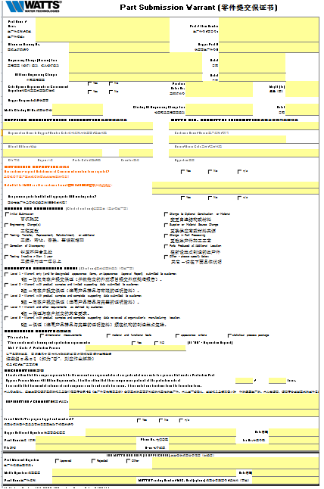
Part Submission Warrant (PSW)
What is it?
Documents required for all newly tooled or revised products in which the supplier confirms that inspections and tests on production parts show conformance to Watts requirements.
Objective or purpose
Used to:
  Document part approval
  Provide key information
  Declare that the parts meet specification.
When to use it
Prior to shipping production parts.

Slide 20

Part Submission Warrant (PSW)
Supplier’s Checklist
Must be completely filled out
Must be signed by the supplier
P/N must match the PO
Submitted at the correct revision level
Submitted at the correct submission level
Specify the reason for submission

Slide 21
Authorized Engineering
Change Documents

Slide 22
Authorized Engineering
Change Notice
The supplier shall provide authorized change documents as required below but not limited to that affects the PPAP:
    Specifications
    Deviations
    MA–Manufacturing Alerts/ECN (must be approved, not pending)
    Feasibility studies (Team Feasibility Commitment next page)
    Supplier change requests
    Sub-assembly drawings
    Life or reliability testing requirements

Slide 23
Team Feasibility Commitment
What is it?
Review required for all new or revised product, tooling etc. in which the supplier confirms that processes, controls, specifications, tests, equipment and costs on production parts meet Watts requirements.
Objective or purpose
Used to:
  Identify controls are in place and being met.
  Declare that the parts meet specifications and requirements.
When to use it
Prior to shipping production parts.

Slide 24
Process Flow Diagram

Slide 25
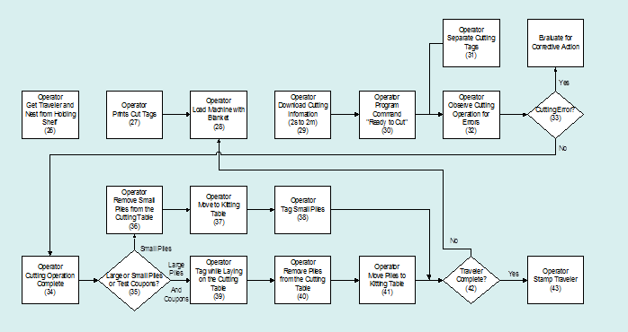
Process Flow Diagram
What is it?
A visual diagram of the entire process from receiving through shipping, including outside processes and services.
Objective or purpose
To help people “see” the real process. Process maps can be used to understand the following characteristics of a process:
  Set-by-step process linkage
  Offline activities (measurement, inspection, handling)
  Rework, scrap.
When to use it
To understand how a process flows.
Prior to completing the PFMEA.

Slide 26
Process Flow Diagrams
PROCESS FLOW DIAGRAM
Part Number:
Date:
Part Description:
ECL:
Prepared By:
Fabrication
Product and
Move
Inspect
STEP
Store
Operation
Item #
Process
Item #
Control Methods
The process flow example diagram utilizes symbols to clearly identify each step in the process.
Description
Characteristics
1
2
3
4
5
6
7
8
9
10
11
12

Slide 27
Process Flow Diagram Example
PROCESS FLOW DIAGRAM
Part No.
:
800-3253535
Customer Name
:
Horton
Doc. No.
:
xyz12364
Part Name :
:
Sample part
Page
:
1 of 1
Rev. No. / Date
:
Rev A 10-11-89
Incoming
CNC Sliding
Deburring & Cleaning
Final Inspection
Inspection
Machining
05
10
15
20
**RM receiving
Patrol Insp.
Insp. report
report
Final Inspection
Pre shipment
Oiling, Packing &
Layout
Pre delivery
register
Despatch
audit
Preservation
Inspection
Inspection
70
60
50
40
30
Pre shipment
Layout Inspection
Self Inspection
audit report
Report
Report
**
Not ok , Rejected
Inspection
If Rejected
Inspection as per
If rework
100%
per AAB
Operation layout
possible
Rework
Re-inspection
Return to
Note :
Not ok , Rejected
Not ok
Ok
supplier
Tags to be provided
Scrap
Next
for OK, Rework, Inspection
operation
& Rejection
- MOVEMENT
- PATROL INSPECTION
- STORAGE
PREPARED BY & DATE
Rbru 10-11-87
APPROVED BY &
- SUPPLIER END OPERATION
- PROCESS
- INSPECTION
DATE
Rose 12-09-87

Slide 28
Process Flow Diagrams
Suppliers Checklist
Process Flow must identify each step in the process.
Should include abnormal handling processes.
  Scrap
  Rework
Process Flow must include all phases of the process.
  Receiving of raw material
  Part manufacturing
  Offline inspections and checks
  Assembly
  Shipping

Slide 29
Process FMEA

Slide 30
Process FMEA ( PFMEA)
What is it?
A tool used to identify and prioritize risk areas
and their mitigation plans.
Objective or purpose
Identifies potential failure modes, causes, and effects. Inputs come from the process flow diagram.
Identifies key inputs which positively or negatively affect quality, reliability and safety of a product or process. A proactive approach used to manage risk.
When to use it
After completion of the process flow diagram.
Prior to tooling for production.

Slide 31
PFMEA Example Steps 1and 2
1
2
Potential
Potential
Process Step
Potential Failure
Effect(s) of
Sev
Class
Cause(s)/
Occur
Current Process
Detect
R.P.N.
Mode
Failure
Mechanism(s)
Controls
of Failure
Op 70: Manual
Insufficient wax
Allows integrity
7
Manually
8
Variables check
5
280
application of
coverage over
breach of inner
inserted spray
for film
wax inside door
specified surface
door panel
head not
thickness; Visual
panel
inserter far
check for
Corroded interior
enough
coverage
lower door
panels
Deteriorated life
Spray head
5
Variables check
5
175
of door leading
clogged:
for film
to:
- Viscosity too
thickness; Visual
- Unsatisfactory
high
check for
appearance due
- Temp too low
coverage; Test
to rust through
- Pressure too
spray at start-up
paint over time
low
and after idle
- Impaired
periods and
function of
preventative
interior door
maintenance
program to clean
1. There should be at least one potential failure mode for each process step.
2. There should be at least one failure effects for each potential failure mode.
Effects should be specific, clear, and leave no doubt to the uninformed reviewer.
hardware
heads

Slide 32
PFMEA Example Steps 3 and 4
3
4
3. There should be at least one potential cause for each failure mode.
4. This step in the FMEA begins to identify initial shortcomings or gaps in the current control plan. If a procedure exists, enter the document number. If no current control exists, leave block as a “NONE.”

Slide 33
PFMEA Step 5
Assign Severity, Occurrence, and Detection ratings
5
5
5
5. Severity, Occurrence and Detection rating details on next slide.

Slide 34
PFMEA - Definition of Terms
Severity (of Effect) - Severity of the effect on the customer and other stakeholders (Higher Value = Higher Severity).
Occurence (of Cause) - Frequency with which a given failure occurs and creates failure mode (Higher Value = Higher Probability of Occurrence).
Detection (Capability of Current Controls) - Ability of current control scheme to detect the cause before creating the failure mode and/or the failure mode before suffering the effect. (Higher Value = Lower Ability to Detect).
Notice the scale difference for Detection on the next page.

Slide 35

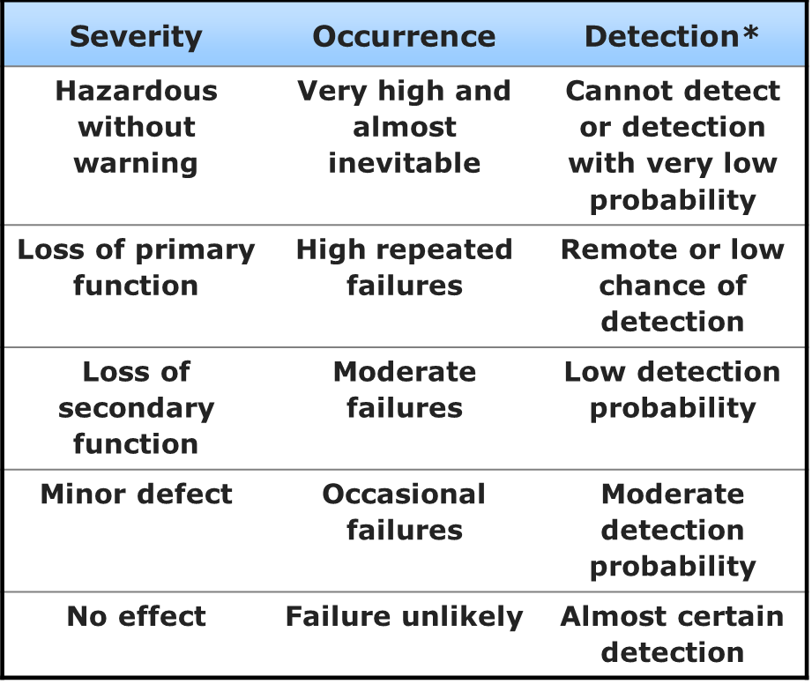
An Example of Rating Definitions
Rating
High 10
Low 1
*If No Controls Exist, Detection = 10
Create a rating system that makes sense for the
defects you are trying to prevent.

Slide 36
PFMEA - Step 6
6
Calculate the Risk Priority Number (RPN)
RPN = Severity x Occurrence x Detection
6. The RPN is used to prioritize the most critical risks identified in the first half of the FMEA.
High RPNs are flags to take efforts to reduce the calculated risk.
Regardless of RPN, high severity scores (9 or 10) should be given special attention.

Slide 37
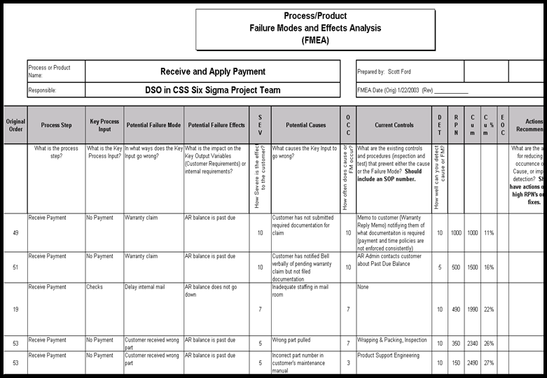
Analyzing the PFMEA
Once the RPN numbers are determined, they can be used to prioritize the most significant failure modes.
Sort the FMEA by the RPN numbers. Graphical and statistical tools can help the team select a “cut-off” RPN for the next steps.
Sort by RPN to determine
the most significant
failure modes
RPN Thresholds
  When using an RPN threshold, DO NOT forget to address high scores.

Slide 38
PFMEA – Remediation Guidelines
Severity – Can only be improved by a design change to the product or process.
Occurrence – Can only be reduced by a change which removes or controls a cause. Examples are redundancy, substituting a more reliable component or function or mistake-proofing.
Detection – Can be reduced by improving detection. Examples are mistake-proofing, simplification and statistically sound monitoring.

Slide 39
PFMEA – Step 7
Determine Actions Recommended to reduce High RPNs
7
7. The higher RPN’s need to be reviewed for determined actions.

Slide 40
FMEA – Steps 8,9 and 10
8
9
Now recalculate your RPNs
based on mitigation plans.
8. Responsibility - Assign a specific person who will be responsible for the recommended actions.
9. As actions are completed, document it in the Actions Completed column.
SEV, OCC, DET, RPN – As actions are complete reassess the Severity, Occurrence and Detection and recalculate RPN. Continue RPNs until all risks (are below 100).

Slide 41
Summary Steps To Complete a FMEA
For each process input, determine the ways in which the process step can potentially fail. These are (failure modes).
For each failure mode associated with the inputs, determine effects on the outputs.
Identify the potential causes of each failure mode.
List the current ccontrols for each cause.
Assign severity, occurrence and detection ratings after creating a ratings key appropriate for your project.
Calculate RPN.
Determine the recommended actions to reduce High RPNs.
Take appropriate actions and ddocument the issue.
Recalculate RPNs.
Revisit steps 7 and 8 until all the significant RPNs have been addressed.
A FMEA is living document that must be reviewed
and updated as processes change

Slide 42
Control Plan

Slide 43
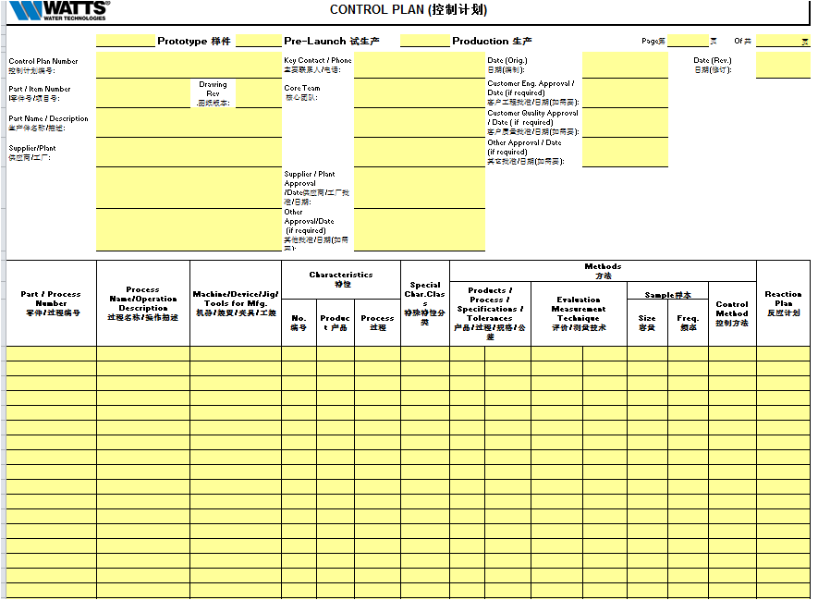
Control Plan
What is it?
A document that describes how to control the critical inputs to continue to meet Watts expectations of the new output.
Objective or purpose
Primary reference source for minimizing process and product variation.
Description of how teams should react to out-of-control situations.
When to use It
Implementation of new process.
Following a process change.
A control plan is considered a living document
as processes are expected to be continuously
updated and improved.

Slide 44
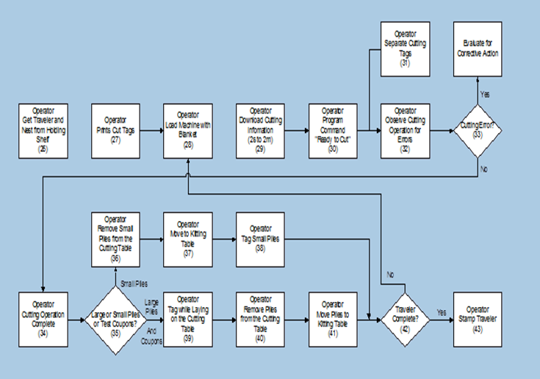
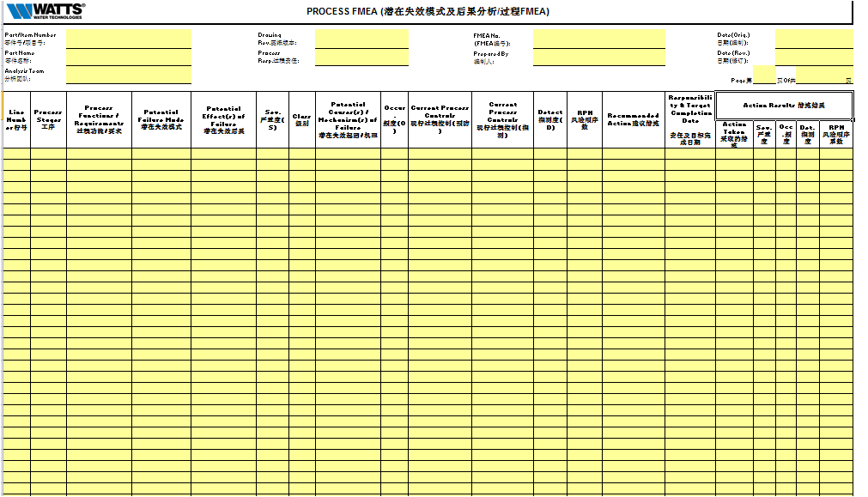
Control Plan
Interaction of Tools
Process Steps
New/Revised Process Steps
Process Flow chart
Process FMEA
Risk Prioritized
Process Steps
Process Steps
New/Revised
Process Steps
Improved
Controls
Control Plan

Slide 45
Control Plan
A Control Plan addresses the areas below:
Three Distinct Phases – prototype, pre-launch and production.
Administrative section – Identifies part numbers and descriptions, supplier, required approvals, signature and dates.
Part/Process requirements, characteristics of product or process, machine /tools that are used in the manufacturing process.
Specifications/tolerances, measurement technique, sample size and frequency.
Control methods, and reaction plans.

Slide 46
Control Plan
Suppliers Checklist
Use process flow diagram and PFMEA to build the control plan; keep them aligned.
Controls must be used to be effective. Keep it simple.
Ensure that the control plan is in the document control system of the business.
Good control plans address:
  All testing requirements - dimensional, material, and performance.
  All product and process characteristics at every step throughout the process.
The control method should be based on an effective analysis of the process.
  Such as SPC, Inspection, Sampling Plan.
Control plans should reference other documentation.
  Specifications, tooling, etc.

Slide 47
Measurement System Analysis (MSA)

Slide 48
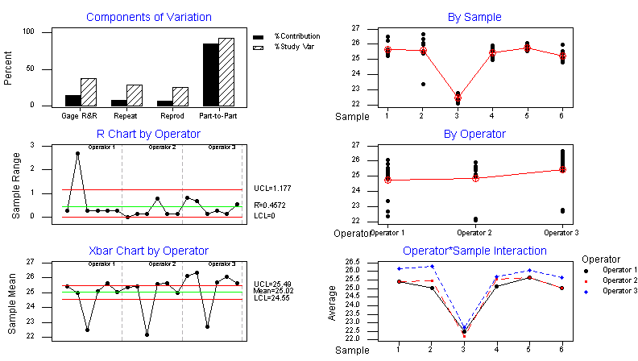
Measurement System Analysis (MSA)
What is it?
An MSA is a statistical tool used to determine if a measurement system is capable of precise measurement.
Objective or purpose
To determine how much error is in the measurement due to the measurement process itself.
Quantifies the variability added by the measurement system.
Applicable to attribute data and variable data.
When to use it
On the critical inputs and outputs prior to collecting data for analysis.
For any new or modified process in order to ensure the quality of the data.
IMPORTANT!
Who should be involved
Measurement System Analysis is
an analysis of the process,
not an analysis of the
people!
Everyone that measures and makes decisions about these measurements
should be involved in the MSA.

Slide 49
Types of Data -Attribute and Variable MSA
  Attribute Data Examples:
    Count, pass/fail, yes/no, red/green/yellow, timekeeping buckets
  Variable Data Examples:
    Physical measurement (length, width, area, …)
    Physical conditions (temperature, pressure…)
    Physical properties (strength, load, strain…)
    Continuous or non-ending
Unless approved by Watts attribute data
is not acceptable for PPAP submission

Slide 50
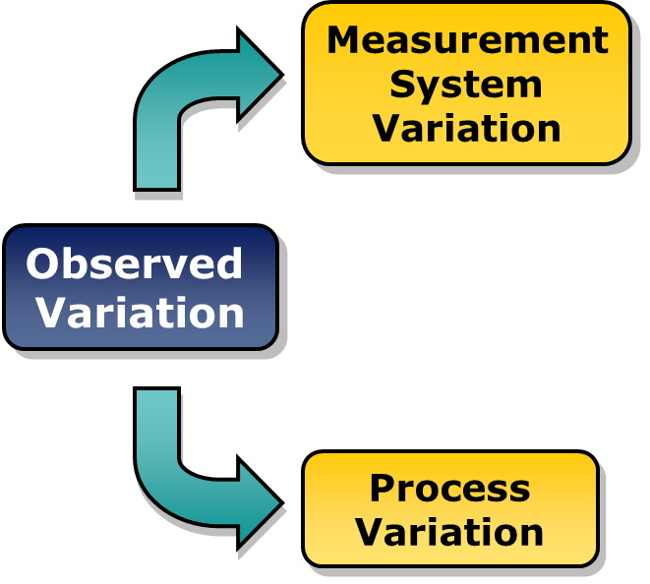
Measurement System Analysis (MSA)
The observed variation in process output measurements is not simply the variation in the process itself; it is the variation in the process plus the variation in measurement that results from an inadequate measurement system.

Slide 51
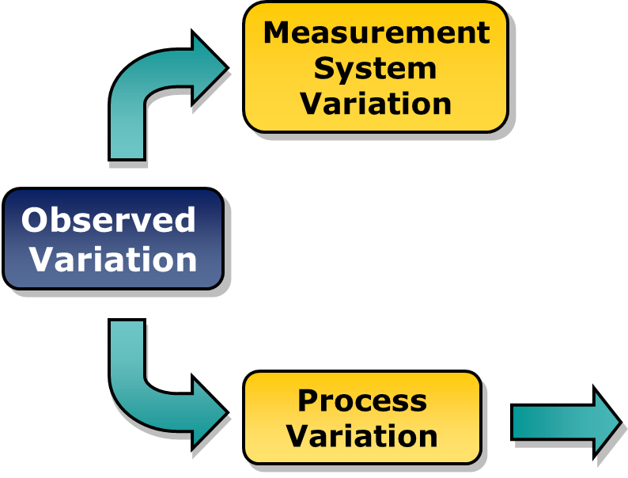
Measurement System Analysis (MSA)
Observed Variation
The output of the process
measured by:
Cycle time
Dimensional data
Number of defects
and others

Slide 52

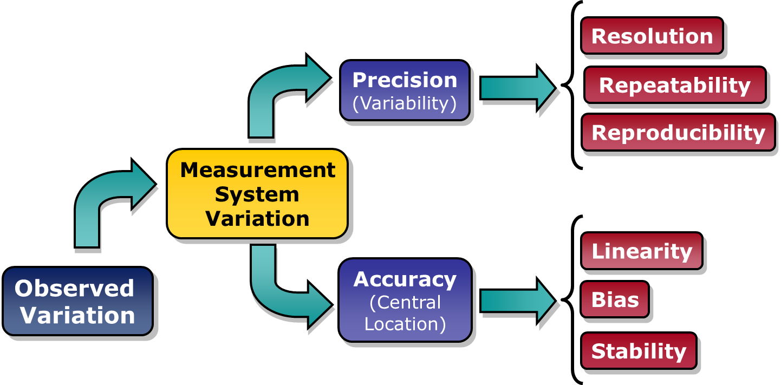

Measurement System Analysis (MSA)
Process
Variation
Calibration addresses accuracy

Slide 53
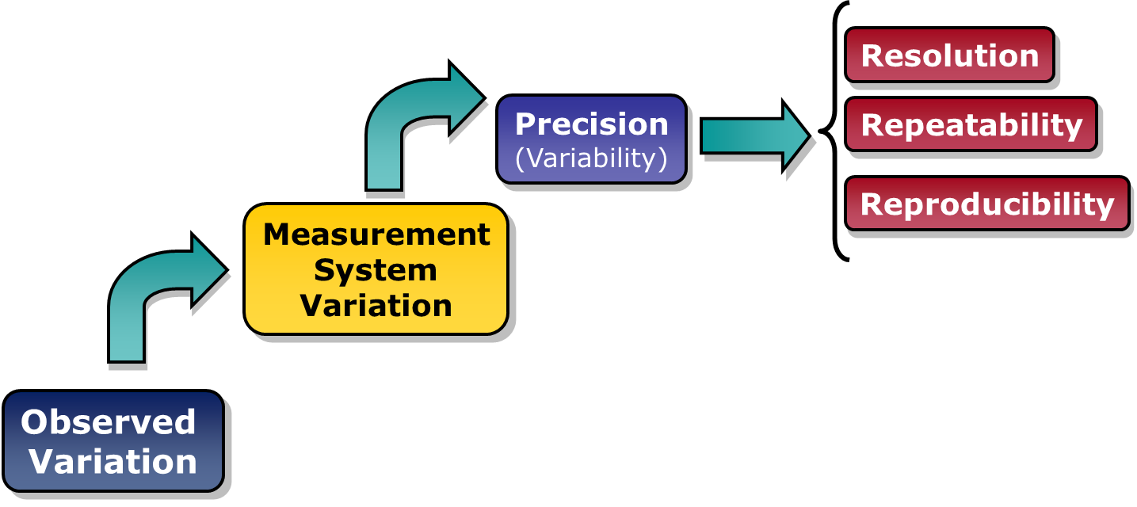
Measurement System Analysis (MSA)
Linearity
Accuracy
(Central
Location)
Bias
Stability
Process
Variation
Let’s take a closer look at Precision

Slide 54


Measurement System Analysis (MSA)
Resolution
Error in Resolution
The inability to detect small changes.
Possible Cause
Wrong measurement device selected - divisions on scale not fine enough to detect changes.

Slide 55



Measurement System Analysis (MSA)
Error in Repeatability
The inability to get the same answer from repeated measurements made of the same item under absolutely identical conditions.
Possible Cause
Lack of standard operating procedures (SOP), lack of training, measuring system variability.
Equipment Variation

Slide 56
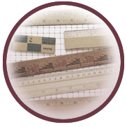

Measurement System Analysis (MSA)
Reproducibility
Error in Reproducibility
The inability to get the same answer from repeated measurements made under various conditions from different inspectors.
Possible Cause
Lack of SOP, lack of training.
Appraiser Variation

Slide 57
Variable MSA – Gage R&R Study
Gage R&R is the combined estimate of measurement system Repeatability and Reproducibility.
Typically, a 3-person study is performed
  Each person randomly measures 10 marked parts per trial.
  Each person can perform up to 3 trials.
There are 3 key indicators:
  EV or Equipment Variation
  AV or Appraiser Variation
  Overall % GRR

Slide 58
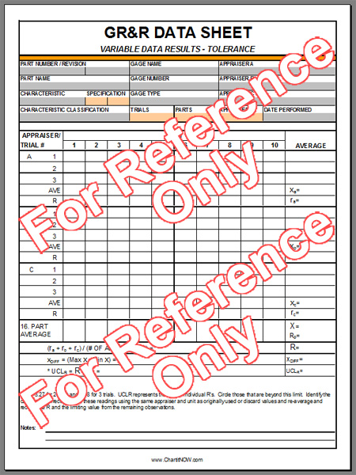
Variable MSA – Example Gage R&R Form
Suppliers shall use their own Gage R & R forms to address the requirements for Measurement System Analysis (MSA).

Slide 59
Variable MSA – Gage R&R Steps
Step 1
Step 2
Step 3
Step 4
Step 5
Step 6
Step 7
Step 8
Step 9
Step 10
Select 10 items that represent the full range of long-term process variation.
Identify the appraisers.
If appropriate, calibrate the gage or verify that the last calibration date is valid
4. Have your Gage R & R form available to record data.
Have each appraiser assess each part 3 times (trials – first in order, second in reverse order, third random).
Input data into the Gage R&R worksheet.
Enter the number of operators, trials, samples and specification limits
8. Analyze data in the Gage R&R worksheet.
9. Assess MSA trust level. ( > 30% fail) (10-30% marginal) ( <10% pass)
10. Take actions for improvement if necessary.

Slide 60
Tips and Lessons Learned
Important: An MSA is an analysis of the process, not an analysis of the people. If an MSA fails, the process failed.
A Variable MSA provides more analysis capability than an Attribute MSA. For this and other reasons, always use variable data if possible.
The involvement of people is the key to success.
  Involve the people that actually work the process
  Involve the supervision
  Involve the suppliers and customers of the process
An MSA primarily addresses precision with limited accuracy information.

Slide 61
MSA Review
Supplier’s Checklist
If the gage/inspection affects quality and used for product acceptance, then conduct a Gage R&R.
Make sure the study is recent - less than 1 year.
Compare the control plan gages against the Gage R&Rs.
If you question that gage, then;
  Question the technique and part sampling.
  Ask for additional studies.

Slide 62
Dimensional Results

Slide 63
Dimensional Results
What is it?
Evidence that dimensional verifications have been completed and results indicate compliance with specified requirements.
Objective or purpose
To show conformance to the customer part print on dimensions and all other noted requirements.
When to use it
For each unique manufacturing process (e.g., cells or production lines and all molds, patterns, or dies.

Slide 64
Dimensional Requirements
The Supplier shall provide the number of sample parts as specified on the PPAP. The specific sample size will be determined based on factors such as component size, complexity, projected volume, etc.
Take or make samples from actual production tooling and /or processes unless otherwise approved in writing. Where multiple production molds, cavities, dies, machines, etc., are utilized, samples are required from each. For any questions consult Watts for data requirements.
Complete a Dimensional report for five parts. The dimensional report is a comprehensive inspection report of the part being qualified. It is considered a full part layout and must accompany all samples submitted. It includes measurement and verification of all dimensions, drawing notes, engineering specifications and quality standards. This is sometimes referred to as a First Article Inspection (FAI).
Actual variable data must be provided in terms of measurements, not attribute (pass / fail; go / no go; etc.) data. All results must be traceable to the specific samples from which obtained.
The sample parts must be shipped with a copy of the dimensional report work sheet. These parts when shipped need to be identified as PPAP samples using the Watts PPAP sample label that can be obtained on the Watts supplier website. www.wattswater.com/Suppliers from the (PPAP) link.

Slide 65
Dimensional Checklist
A Watts determined quantity of parts are required for part qualification. These initial production parts must be identified when shipped for the first time.
Five of these parts must be shipped to Watts for verification of form, fit, and function and properly labeled.
The same five parts will be used to verify both critical and non-critical dimensions.
Supplier must clearly identify the production sample parts that are being shipped with Watts PPAP sample label.
Supplier should make every effort to ship five parts that represent both the low and high ends of the specifications for dimensions.

Slide 66
Records of Material
/ Performance Test
Results

Slide 67
Records of Material Test Results
Records of Material Test Results
Material Test Results
The supplier shall have records of material test results for the correct raw material/grade as specified on the design record or control plan.
The supplier shall perform tests for all parts and product materials when chemical, physical, or metallurgical requirements are specified by the design record or control plan and list the tests performed on the form.
Example
Material Specification /Chemicals Comp/Physical 材料规格/化学成分/物理特性 | Specification Limits 规格/限制 |  | Test Date 测试日期 | Qty. Tested 测试数量 | Test Results 测试结果 | OK 合格 | Not OK 不合格
DOW CONTINUUM DGDA-2490 BK |  |  | 1/1/12 | 1 | provided material cert | x

Slide 68
Records of Performance Test Results
Records of Performance Test Results
Performance Test Results
The supplier shall have records of performance test results for tests specified by the design record or control plan.
The supplier shall perform tests for all part(s) or product material(s) when performance or functional requirements are specified by the design record or control plan.
Example
Test Specification / Rev / Date 测试规格/版本/日期 | Specification / Limits 规格/限制 |  | Test Date 测试日期 | Qty. Tested 测试数量 | Supplier Test Results (Data) / Test Conditions 供应商测试结果(数据)/测试条件 | OK 合格 | Not OK 不合格
temp 10C to 85C | 10c | 85c | 4/2/14 | 1 | Test report provided | x

Slide 69
Material/ Performance Review
Reviewers Checklist
For products with Watts-developed material specifications and or an Watts-approved supplier list, the supplier shall procure materials and or services from suppliers on that list.
Supplier shall address all areas on the Watts form(s) to meet the PPAP requirements for both Material and Performance requirements.

Slide 70
Initial Process Study

Slide 71
Initial Process Study
S = Supplier shall submit to Watts a copy of the records or documented items at appropriate locations.

Slide 72
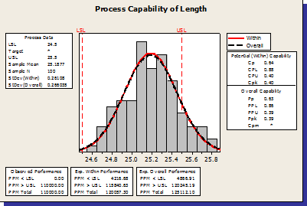
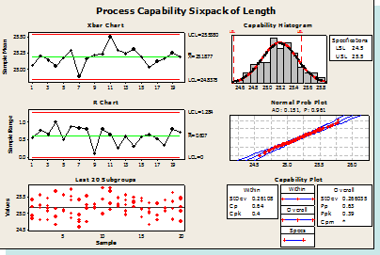
Initial Process Study
What is it?
A set of tools used to understand process capability.
Objective or purpose
To evaluate the performance of
your process as compared to specification limits.
To determine if the production process is likely to produce product that will meet customer requirements.
When to use it
To establish base line capability.
To validate process improvements.

Slide 73
Steps for Determining Process Capability
Step 1
Step 2
Step 3
Step 4
Step 5
Step 6
Step 7
Decide on the product or process characteristic to be assessed (required or all critical characteristics).
Validate the specification limits ( through customers, suppliers, controlling agencies).
Validate the measurement system through appropriate (MSA).
Collect data
  Short term data:
    Free of special causes
    Collected across a narrow inference space i.e. one shift, one machine, one operator, etc..
  Long term data:
    Subjected to the effects of both random and special cause variation.
    Collected across a broad inference space i.e. multiple shifts, machines, operators, etc.

Slide 74
Steps for Determining Process Capability
Step 1
Step 2
Step 3
Step 4
Step 5
Step 6
Step 7
5. Assess Data characteristics - Is it what you would expect? If not, investigate.
*Assess Process stability - Assess process stability in order to understand how your process behaves over time. Control charts are the recommended tool.
  Calculate process capability - Calculate the appropriate statistical metrics in order to determine how the “Voice of the Process” compares to the “Voice of the Customer.”
  Example: Capability Metrics: PPM, DPMO, Cp, Cpk, Pp, & Ppk ; Sigma Levels (Z Scores)
*Capability is only valid when the process being studied is stable!

Slide 75
Focus on Variable Data
The initial process study should be focused on variable, not attribute data.
  Assembly errors, test failures, and surface defects are examples of attribute data, which is important to understand, but is not covered in this initial study.
  To understand the performance of characteristics monitored by attribute data will require more data collected over time.
  Unless approved by an authorized Watts representative, attribute data are not acceptable for PPAP submission.
Focus on variable data

Slide 76
Capability Indices – Cpk & Ppk
Cpk predicts capability:
  Based on short term within subgroup variation.
  Does not include the effect of process variability between subgroups.
Cpk should be used when:
  Developing new parts.
  Revising specifications on a part.
  Materials, processes, manufacturing location, or equipment have significantly changed.
  Material suppliers have changed (include certificate of analysis).
  Ppk indicates past performance:
  Based on long term total variation.
  Unlike Cpk, Ppk is not limited to variation within subgroups.
  However, Ppk cannot isolate within subgroup variation from between subgroup variation.
  When calculated from the same data set, Cpk and Ppk can be compared to analyze the sources of process variation.
  Ppk should be used when:
  The supplier is new to Watts, but has already been manufacturing a part.
  The supplier is existing, but has produced a number of nonconforming parts.

Slide 77
Acceptance Criteria
Capability acceptance criteria for characteristics
For Watts products based on short term capability a 1.33 Cpk or greater is required and for Ppk a 1.67 or greater is required.
For Long Term capability for Watts products the Cpk must be 1.33 or greater for key characteristics.
Suppliers shall ensure that the results are acceptable, and that the process is stable and capable of producing a quality part to watts Requirements.

Slide 78
Qualified Laboratory
Documentation

Slide 79
Qualified Laboratory Documentation
Inspection and testing for PPAP shall be performed by a qualified laboratory as defined by Watts requirements (e.g., an accredited laboratory).
The qualified laboratory (internal or external to the supplier) shall have a laboratory scope and documentation showing that the laboratory is qualified for the type of measurements or tests conducted.
    When an external laboratory is used, the supplier shall submit the test results on the laboratory letterhead or the normal laboratory report format.
    The name of the laboratory that performed the tests, the date(s) of the tests, and the standards used to run the tests shall be identified.

Slide 80
Appearance Approval Report

Slide 81
Appearance Approval Report
What is it?
A report completed by the supplier concerning areas such as paint, plating, appearance, color, grain etc.. that have criteria for these areas.
Objective or purpose
To demonstrate that the part has met the appearance requirements on the design record.
When to use it
Prior to tooling for production.
IMPORTANT!
Typically applies for parts with color, grain,
or surface appearance requirements.

Slide 82
PPAP Sample Productions Parts

Slide 83
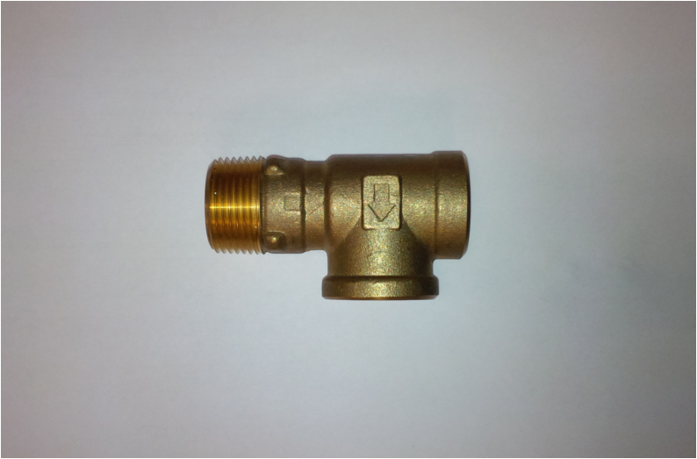
PPAP Sample Production Parts
What is it?
Actual samples that reflect the parts documented in the PPAP.
Objective or purpose
Confirm dimensional, cosmetic or functional part approval.
When to use it
Sample parts should be delivered with the PPAP submission.

Slide 84
PPAP Sample Production Parts
The sample parts provided shall be the same parts measured for the dimensional results.
Where multiple production molds, cavities, dies, machines, etc., are utilized, samples are required from each.
Default quantity for all submissions is 5 parts unless otherwise requested.

Slide 85
PPAP Sample Production Parts
PPAP sample production parts MUST be properly identified.
  At a minimum the following information is required on the PPAP sample label:
    Part/Item number
    Engineering Change level
    Part Name
    Supplier Name
    Supplier Code
    Quantity
See Watts sample part label on the next slide.

Slide 86
PPAP Samples Label
PPAP Label:
Upper half is informational and lower half is the label portion used for identification of shipment.

Slide 87
First Shipment Label for Production Parts

Slide 88
First Shipment Production Parts
First shipment production parts MUST be properly identified.
  Include the following information on the part label:
    New Product – (Mark if this is the first shipment for a new product)
    Process Change - (Mark if this is the first shipment after a process change)
    Design Change - (Mark if this is the first shipment after a design change)
    Watts part number
    Engineering Change level
    Part Name
    Supplier Name
    Supplier Code
    Quantity
See Watts First Shipment label on the next slide

Slide 89
First Shipment Production Parts
First Shipment Label:
Upper half is informational and lower half is the label portion used for identification of shipment.

Slide 90
Packaging Requirements
What is it?
A form that is to be completed by the supplier to identify all areas related to the packaging of the part that is being shipped.
Objective or purpose
To detail how a part is packaged for review and acceptance by the Watts.
When to use it
Prior to first initial shipment of product to the customer.

Slide 91
THANK YOU

